Slide 1





MobiCom 2023
Meta-Speaker: Acoustic Source Projection by
Exploiting Air Nonlinearity
Weiguo Wang
^{Tsinghua University}
Yuan He
^{Tsinghua University}
Meng Jin
^{Shanghai Jiao Tong University}
Yimiao Sun
^{Tsinghua University}
Xiuzhen Guo
^{Zhejiang University}

Slide 2
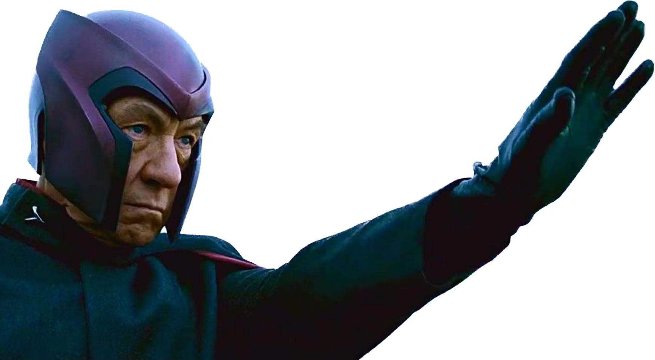
Magneto (Marvel Comics) can generate and control
magnetic fields.
Notes:
I am sure most of you are familiar with this guy, Magneto /mæɡˈniːtoʊ/, a famous character from Marvel Comics.
He possesses a superpower to generate and control magnetic /mæɡˈnetɪk/ fields, which in turn allows him to manipulate metallic objects.
My research interests are acoustic sensing, and Magneto's superpower have always attracted me.

Slide 3
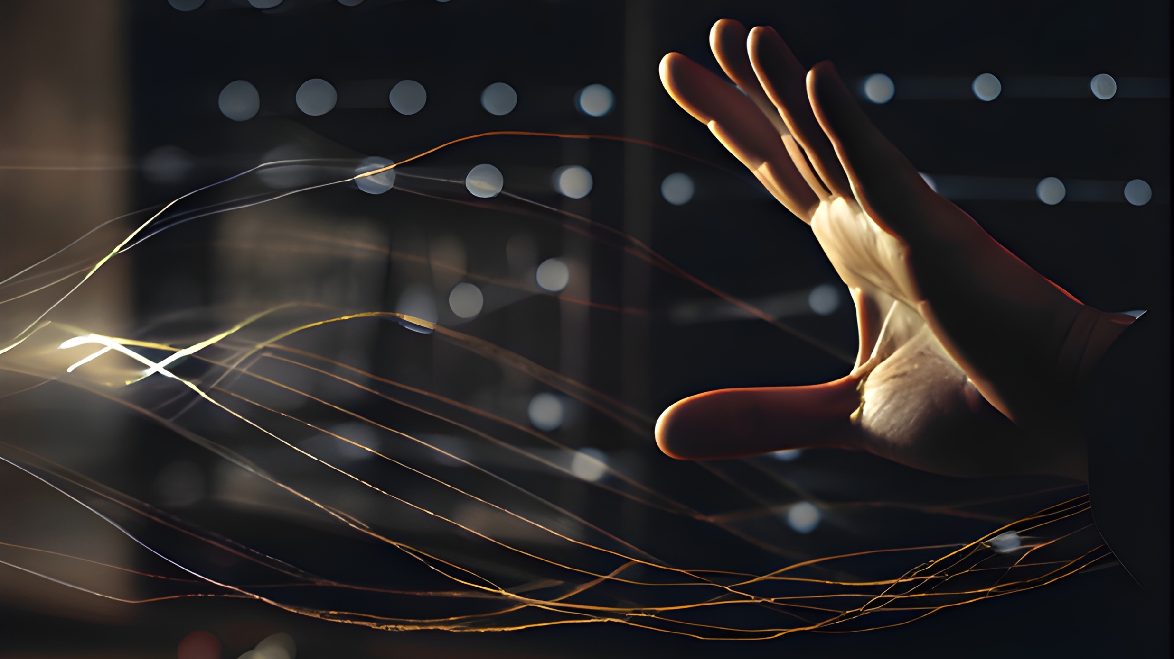
Acoustic Field Manipulation
Can we Manipulate Acoustic Field ?
Notes:
This superpower led me to wonder if it could be possible to manipulate acoustic fields in a similar manner.
Today, I'm excited to present our work – Meta-Speaker – , a novel device, which can give an affirmative answer to this question.
Before introducing the details, let us see some existing approaches.

Slide 4
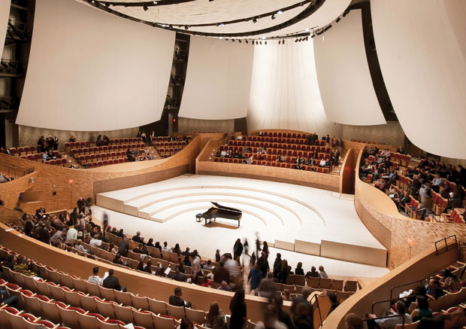
Existing Approaches
Two perspectives to achieving AFM (Acoustic Field Manipulation):
Wave Propagation
The structure of the concert hall is well designed for good auditory experience.

Slide 5

Existing Approaches
Two perspectives to achieving AFM (Acoustic Field Manipulation):
Wave Propagation
redirect reflection
suppress scattering
Recent advances in acoustic metamaterials allow us to control wave propagation in a programmable way.

Slide 6
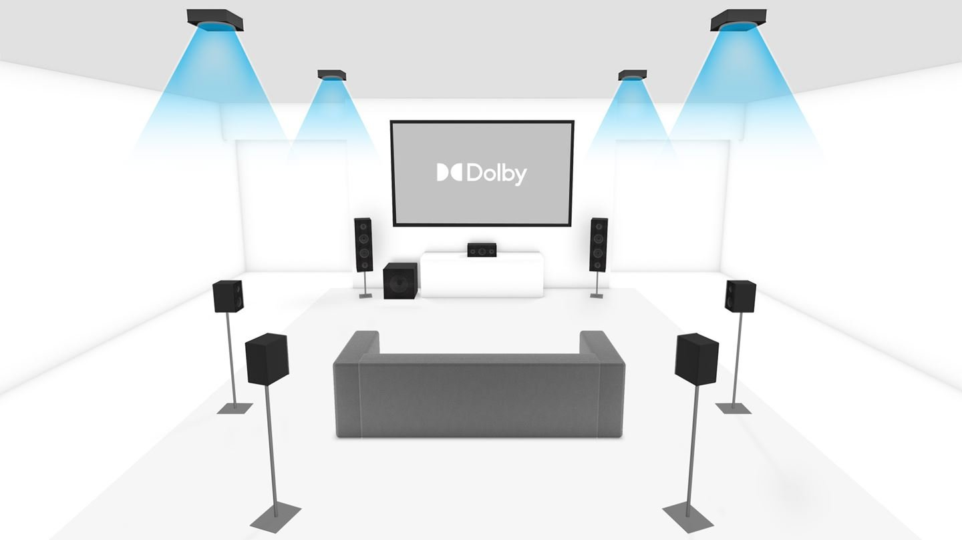
Existing Approaches
Two perspectives to achieving AFM (Acoustic Field Manipulation):
Wave Propagation
Source Projection
By deploying multiple different in a room, Dolby Atomos allows sounds to move freely in 3D space.

Slide 7
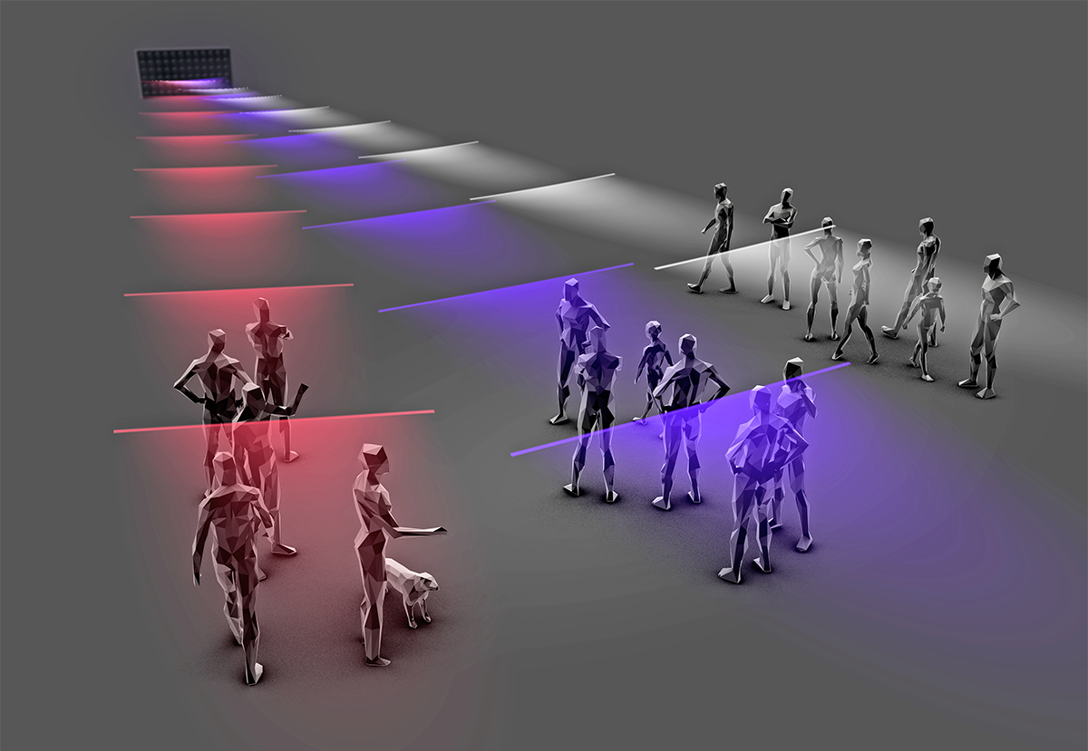
Existing Approaches
Two perspectives to achieving AFM (Acoustic Field Manipulation):
Wave Propagation
Source Projection
Directional Speakers can divide and multiplex acoustic channels spatially.

Slide 8

Meta-Speaker: A novel speaker that can project sounds with a high level of manipulability.
Sound Size can be manipulated
Sound Location can be manipulated
Spatial Audio for HCI
Notes:
We propose a novel device, called Meta-Speaker. Meta-Speaker has three unique meta abilities:
Firstly It can control the sound size, down to a single point.
Secondly，It can also control the sound location.
You can imagine that, with the first two abilities, MetaSpeaker can play point-wise sound sources in a room and move this sound around the room,
Just like Magneto!
What's more, the sound played by MetaSpeaker is spatial audio. Both humans and machines can hear the sound and determine where it comes from. This kind of spatial audio provides great opportunities for interaction with humans and machines.

Slide 9
Air Nonlinearity
The acoustic signal distributes the air medium unevenly, and makes it heterogeneous

Slide 10
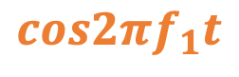
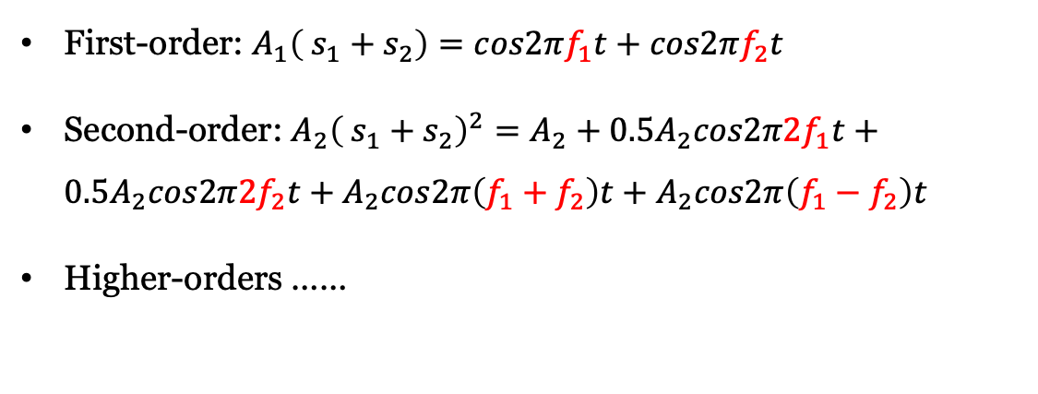
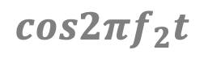
Air Nonlinearity
$$cos2πf_{1}t$$
The acoustic signal distributes the air medium unevenly, and makes it heterogeneous
First-order: $A_{1}\left( s_{1}+s_{2}\right)=cos2πf_{1}t+cos2πf_{2}t$
Second-order: $A_{2}{\left( s_{1}+s_{2}\right)}^{2}=A_{2}+0.5A_{2}cos2π2f_{1}t+0.5A_{2}cos2π2f_{2}t+A_{2}cos2π\left(f_{1}+f_{2}\right)t+A_{2}cos2π\left(f_{1}−f_{2}\right)t$
Higher-orders ……
$$cos2πf_{2}t$$

Slide 11
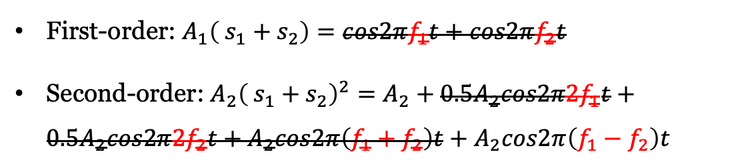
Sound from Silence
$$cos2πf_{1}t$$
The acoustic signal distributes the air medium unevenly, and makes it heterogeneous
First-order: $A_{1}\left( s_{1}+s_{2}\right)=cos2πf_{1}t+cos2πf_{2}t$
Second-order: $A_{2}{\left( s_{1}+s_{2}\right)}^{2}=A_{2}+0.5A_{2}cos2π2f_{1}t+0.5A_{2}cos2π2f_{2}t+A_{2}cos2π\left(f_{1}+f_{2}\right)t+A_{2}cos2π\left(f_{1}−f_{2}\right)t$
$$cos2πf_{2}t$$
Air nonlinearity allows us to reproduce audible sound from ultrasounds.

Slide 12
Meta-Speaker Design
Ultrasound
Ultrasound
Audible Region
By varying the beamwidth, we can manipulate the size of the audible region.
By steering the the array orientation, we can manipulate the location of the audible region.
Ultrasonic Phased Array
Ultrasonic Phased Array
Notes:
Meta-Speaker comprises two distributed ultrasonic arrays, each transmitting a narrow ultrasonic beam. Due to air nonlinearity, a new audible source can be reproduced at the intersection of these ultrasonic beams.
By varying the beam width, we can change the sound size. Generally, the narrower the beam, the smaller the audio size.
Meanwhile, the orientation of arrays can be steered to manipulate the intersection location and, therefore, control the sound location.

Slide 13
Quick Validations
(a) Deployment
(b) P1
(c) P2
(d) P3
Expected audible frequency: 2 kHz
A distinct 2 kHz audio can be recorded at the intersection of beams, P1.
The audio gets much weaker or almost disappears in P2 and P3.
Notes:
To validate this, we let two ultrasonic transmitters projects tones at frequencies of 40 kHz and 42 kHz, respectively.
And record sounds at p1, p2 and p3, as shown in this figure.
As expected, a distinct 2 kHz audio can be indeed reproduced at the intersection of beams, p1.
And the audio gets much weaker or almost disappears at p2 and p3.

Slide 14
Implementation
(a) Hardware design of the transmitter. (b) The array sits on top of a servo motor.
A Raspberry Pi 4B is used as the central controller
A 24-bit DAC, with a sample rate of 96 kHz,
The output from the DAC is amplified using a Class-D power amplifier
The ultrasonic array consists of 16 x 8 transducers
To steer the ultrasonic beam, the array is mounted on top of a servo motor.

Slide 15
Profiling
Spatial Resolution
Energy Distribution
Frequency Response

Slide 16
Profiling: Spatial Resolution
(a) Deployment
(b) 40 kHz (16x8 array)
(c) 42 kHz (16x8 array)
(d) 44 kHz (16x8 array)
The 3-dB beamwidths for the 40 kHz, 42 kHz, and 44 kHz ultrasound frequencies are found to be only 3.1, 2.7, and 2.4 degrees, respectively
The transmitter can form a sharp beam, allowing it to pinpoint a direction precisely.

Slide 17
Profiling: Spatial Resolution
(a) 16 x 8 array
(a) 8 x 8 array
(a) 4 x 8 array
(a) 2 x 8 array
(a) 1 x 8 array
The 3-dB beamwidths for the 40 kHz, 42 kHz, and 44 kHz ultrasound frequencies are found to be only 3.1, 2.7, and 2.4 degrees, respectively
The transmitter offers flexible manipulability over its spatial resolution by enabling transducers selectively.

Slide 18
Profiling: Energy Distribution
(a) Deployment
(b) 2 kHz
(c) 40 kHz
(d) 42 kHz
A two-dimensional slide module workbench is used to carry the microphone to measure the signal energy across a 1m x 1m area with a grid size of 20 mm.
Meta-Speaker can reproduce a point-wise audible source at the intersection of two ultrasonic beams.

Slide 19
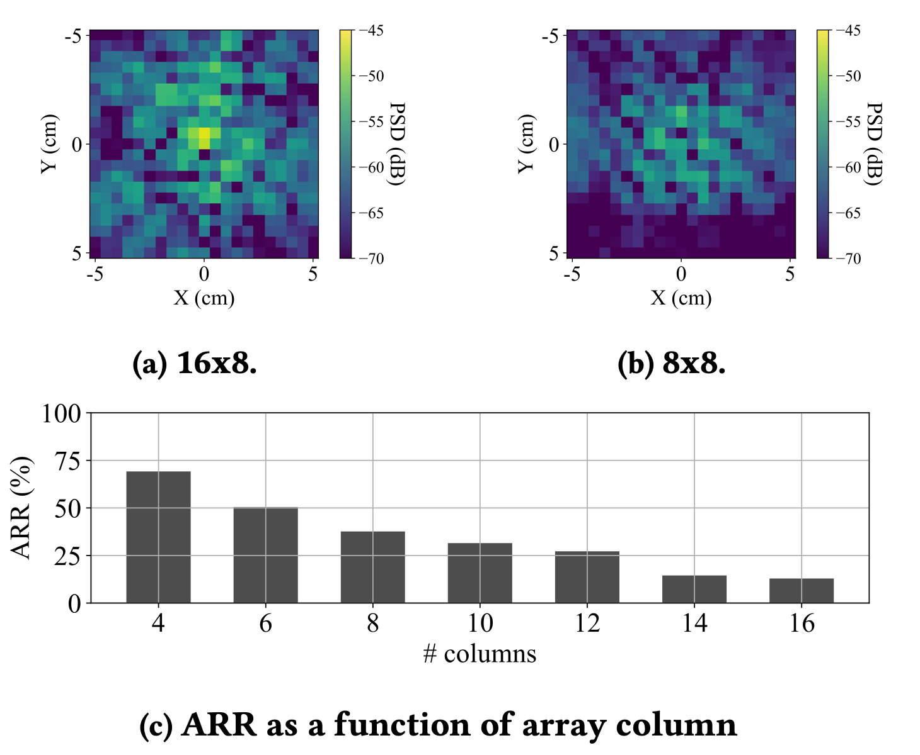
Profiling: Energy Distribution
The impact of array column on audible region size.
As the number of columns increases, the beam becomes sharper and the audible region becomes finer.
The size of the audible region can be manipulated by adjusting the beamwidth of the transmitter.

Slide 20
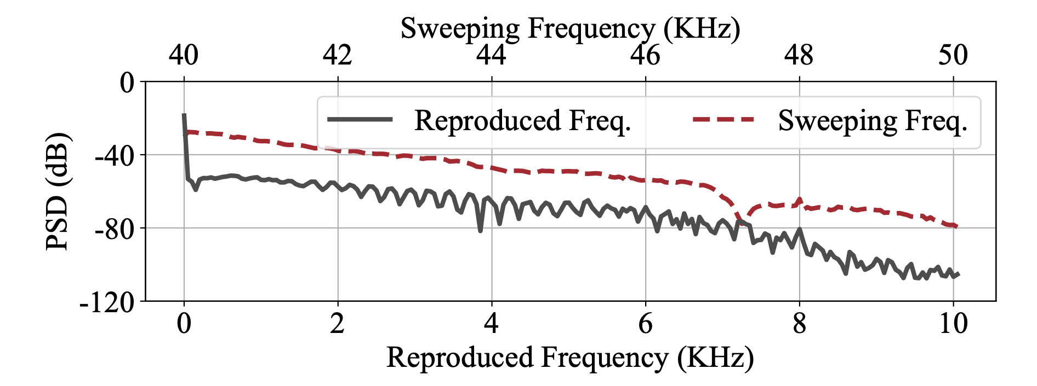
Profiling: Frequency Response
Reproduced frequency vs. sweeping frequency
The bandwidth of Meta-Speaker is approximately 3.8 kHz.

Slide 21
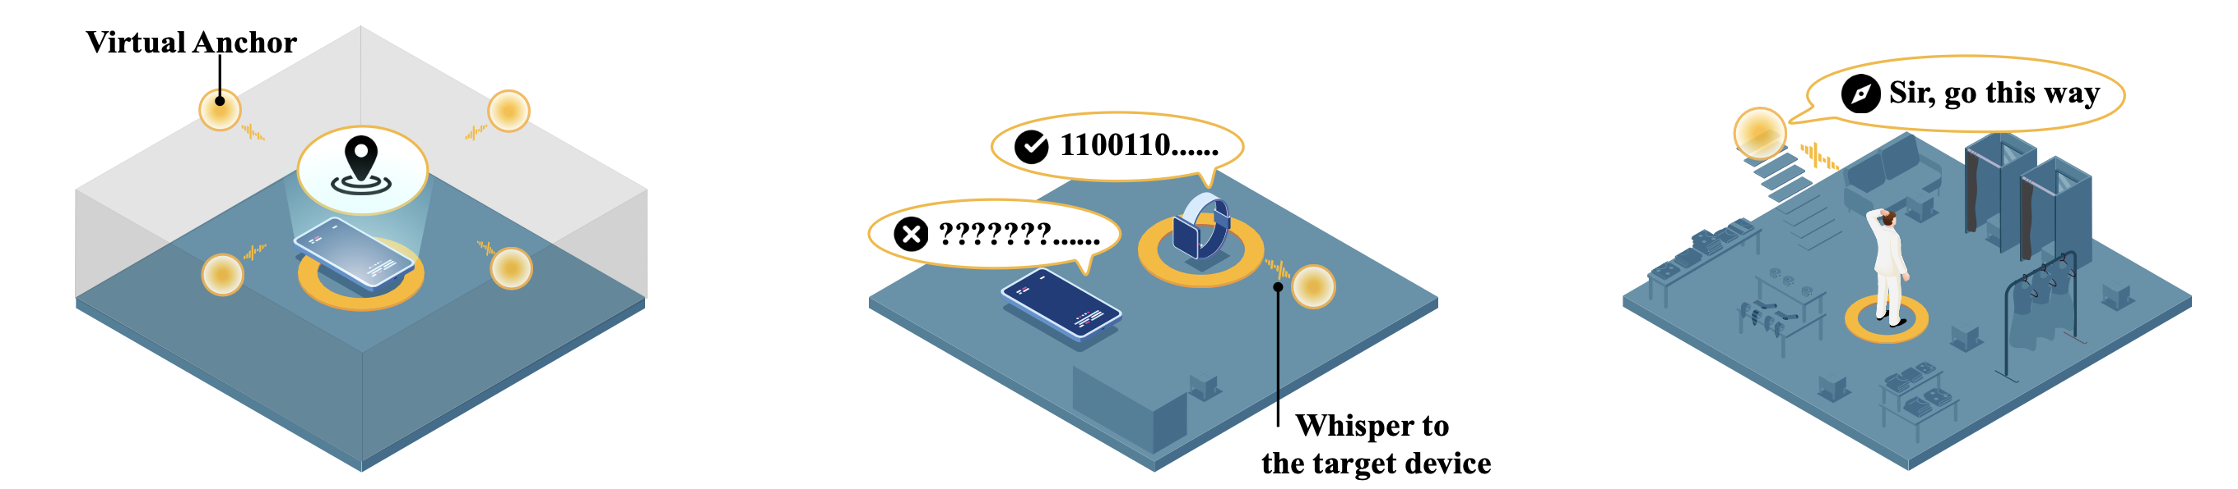
Applications
(a) Anchor-Free Localization
(b) Location-aware Communication
(c) Acoustic Augmented Reality
…… and more possible applications !

Slide 22
Application 1: Anchor-Free Localization
Meta-Speaker can create multiple virtual anchors that broadcast acoustic beacons, by projecting audible sources at different locations

Slide 23
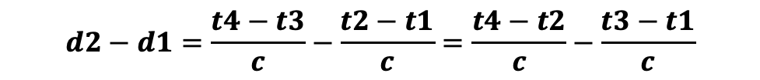

Application 1: Anchor-Free Localization
Illustration of Virtual Anchors
The timelines of beacon transmission and reception
Estimate Direction of Arrival from distance difference:
Estimate distance difference from time difference:
$$θ=\arccos\left(\frac{Δd}{d}\right)=\arccos\left(\frac{d2−d1 }{d}\right)$$
$$d2−d1=\frac{t4−t3}{c}−\frac{t2−t1}{c}=\frac{t4−t2}{c}−\frac{t3−t1}{c}$$
constant

Slide 24
Application 1: Anchor-Free Localization
As increasing the inter-anchor distance from 1m to 2m, the median errors decreases
from 0.27 m to 0.13 m for the virtual anchors,
and from 0.23 m to 0.03 m for the physical anchors.
Physical Anchors vs. Virtual Anchors
Meta-Speaker can further improve the localization performance by manipulating the locations of virtual anchors.

Slide 25
Application 2：Location-aware Communication
Acoustic messages can be transmitted solely to a targeted device, while devices located elsewhere cannot perceive such messages.

Slide 26
Application 2：Location-aware Communication
Impact of projection distance on SER and BER
Impact of symbol length on SER and BER
The projection distance is about 6 m
The communication throughput is up to 1.28 kbps.

Slide 27
Application 3：Acoustic Augmented Reality
The physical presence of the reproduced audio in space allows humans to hear it spatially. This feature enables Meta-Speaker to interact directly with humans.

Slide 28
Application 3：Acoustic Augmented Reality
Direction Estimation Accuracy
Acceptance Score
The sounds that can be spatially perceived by humans with reasonable accuracy and acceptance.

Slide 29
Summary
We propose a new tool for AFM, and demonstrate the feasibility of projecting audible sources with separated ultrasonic beams.
We present the design and implementation of Meta-Speaker. We conduct thorough analysis on its fundamental properties.
Meta-Speaker will enable diverse applications. We showcase three examples:
anchor-free localization
location-aware communication
acoustic augmented reality.
…..

Slide 30

Thank You!
Notes:
That’s all Thank you.

